Slide 2
ABSTRACT
We have designed a Smart Voting Machine where there is no need for the user to carry his ID which contains his required details. The person at the polling booth needs only to place his Finger in finger print scanner and capture the face identity in web camera at the counter of the polling booth, thus allowing the acquisition of an on-spot Fingerprint and Face from the voter which serves as an identification. This data is passed on to the controlling unit for the verification. The controller fetches the data from the reader and compares this data with the already existing data stored during the registration of the voters. If the data matches with the pre-stored information of the registered fingerprint and Face, the person is allowed to cast his vote. If not, a warning message is displayed on LCD and warns through the voice by this way, the person is barred from polling his vote.

Slide 3
INTRODUCTION
Biometrics is the science and technology of measuring and analyzing biological data. In information technology, biometrics refers to technologies that measure and analyze human body characteristics, such as DNA, fingerprints, eye retinas and irises, voice patterns, facial patterns and hand measurements, for authentication purposes. In this paper we have used thumb impression for the purpose of voter identification or authentication. As the thumb impression of every individual is unique, it helps in maximizing the accuracy. A database is created containing the face images of all the voters in the constituency. Illegal votes and repetition of votes is checked for in this system. Hence if this system is employed the elections would be fair and free from rigging. Thanks to this system that conducting elections would no longer be a tedious and expensive job.

Slide 4
EXISTING METHOD
Electronic Voting Machine(EVM) which is currently in use :
Security Problems - One can change the program installed in the EVM and tamper the results after the polling. By replacing a small part of the machine with a look-alike component that can be silently instructed to steal a percentage of the votes in favor of a chosen candidate. These instructions can be sent wirelessly from a mobile phone.
Illegal Voting (Rigging) - The very commonly known problem, Rigging which is faced in every electoral procedure. One candidate casts the votes of all the members or few amounts of members in the electoral list illegally. This results in the loss of votes for the other candidates participating and also increases the number votes to the candidate who performs this action. This can be done externally at the time of voting.

Slide 5
PROBLEM IDENTIFICATION IN PROPOSED SYSTEM
The aim of working on the Finger print sensor and face recognition system is to develop a system with increased Performance and accuracy .
A biometric system is essentially a pattern recognition system that operates by acquiring biometric data from an individual, extracting a feature set from the acquired data, and comparing this feature set against the template set in the database.
Finger print recognition is that it is not affected by dryness or roughness of skin or by physical injury on surface of the hand but sometimes the temperature and humidity can affect the quality of the captured image

Slide 6
BLOCK DIAGRAM
Power
supply
MICRO
CONTROLLER
OR
COMPUTER
LCD DISPLAY
FINGER PRINT SENSOR
CAPACITIVE TOUCH PAD
RS232
CAMERA
PC

Slide 7
HARDWARE
Power supply unit
Fingerprint sensor
Microcontroller [ATmega 8A]
RS 232
16*2 LCD DISPLAY
Capacitive touch pad
Push buttons
Led indication

Slide 8
SOFTWARE
Mat lab 8.1
Platform - AVR STUDIO
In System Programmer - ProgISP 172
Compiler – Win AVR

Slide 9
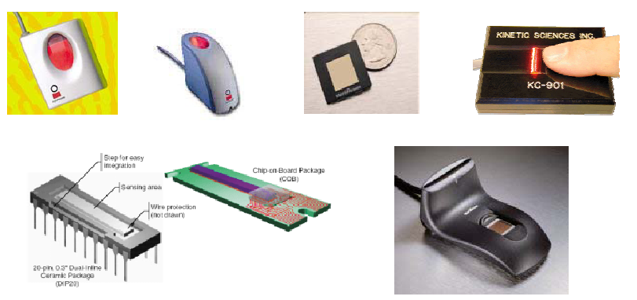
Fingerprint Sensors

Slide 10

Fingerprint Recognition
Fingerprint recognition is one of the oldest and most
researched fields of biometrics.
Some biological principles (Moenssens 1971) related
to fingerprint recognition are as follows:
Individual epidermal ridges and furrows have different characteristics for different fingerprints.
This forms the foundation of fingerprint recognition
The configuration types are individually variable; but they vary within limits that allow for a systematic classification.
Herein lies the basis for fingerprint classification.
The configuration and minute details of furrows are permanent and unchanging.

Slide 11
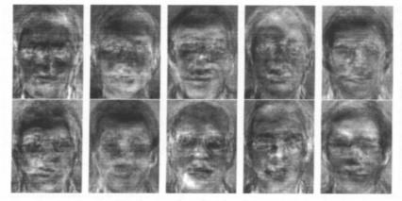
Face
Principal Component Analysis

Slide 12


A Multi-model System
User / Person
Sensors
Extractors
Classifiers
Negotiator
Key
Accept/
Reject
ID
Face
Extractor
Face
Feature
Face
MLP
Image
2D (bmp)
Notes:
The objective of the project!
The approach: use several algorithms manipulating the same data.

Slide 13
LITERATURE SURVEY
Hanady Hussien, Hussien Aboelnaga, IEEE 2013. “Design of secured E-voting systems.” is able to desire with the widespread use of computers and embedded systems. Security is the essential problem should be considered in such systems. This paper proposes a new e-voting system that fulfils the security requirements of e-voting. It is based on homomorphic property and blind signature plan. The suggest system is executed on an embedded system which serves as a voting machine. The system employees RFID to store all conditions that comply with the rule of the government to check voter eligibility.
Daniel petcu, Dan Alexandru stoichescu, The International Symposium on Advanced topics in electrical engineering; May 7-9, 2015. “A Hybrid mobile Biometric- based E- voting system.” Information technology changes and gives shape to networked society all over the world today & its solutions are becoming main drivers in almost all field of human life activity..

Slide 14
LITERATURE SURVEY
M.Venkata Rao, Venugopal Rao Ravula, Pavani Pala. “Development Of Antirigging Voting System Using Biometrics Based On Adharcard Numbering”. Now a day‟s voting process is exercised by using EVM(Electronic voting machine). In this paper we present and use implementation is to execute the progress of anti rigging voting system using finger print .The purpose of the project and implementation is to provide a safety and good environment to the customers is to electing the candidates by using the intelligent electronic voting machine by providing a rival naming to every user using the FINGER PRINT identification technology. Herein this project and satisfy we are going supply the at most security since it is taking the FINGER PRINTS as the authentication for EVM.

Slide 15
MICROCONTROLLER
ATmega8 is the microcontroller used in the project.
The controller has peripheral features like inbuilt ADC, required to get the signals from the sensors.
Maximum clock frequency is 20MHz and hence faster than 8051.
Based on RISC and Harvard architecture and hence even more faster.
Embedded C is used for programming the microcontroller.

Slide 16
Advantages
Rigging will be eliminated completely
Highly tamper – proof.
This unique fingerprint voter ID card can be used for identification purpose in Govt/Semi-Govt bodies. E.g.: When applying Passport, Driving license, etc
Preserves voting secrecy, No scope for invalid votes
This system allows only authenticated voting than the existing equipment as the person is identified based on his Fingerprint and Face Recognition which is unique to each individual.
Low power consumption
It is economical
Less manpower required
Time conscious, less time required for voting & counting • Avoids invalid voting as it prevents unregistered voters from voting. .

Slide 17
REFERENCES
F. S. Wood, “Electric voting-machine”, U.S. Patent 616,174, Granted Dec. 20, 1898.
J. Fried and A. Lee, “Study On Open Source Voting Systems”, Draft Report, San Francisco Local Agency Formation Commission, 2015.
Wikipedia, “Electronic voting”, 2015. [Online]. Available: https://en.wikipedia.org/wiki/Electronic_voting.
A. Boyle, 'Pentagon launches Internet voting effort for overseas Americans', MSNBC, 2003.
D. Jefferson, A. Rubin, B. Simmons, and D. Wagner. “A Security Analysis of the Secure Electronic Registration and Voting Experiment (SERVE)”. Technical report, 2004.
GIAC Security Essentials Certification, “Trusting the machine: inherent problems with electronic voting systems”, Global Information Assurance Certification Paper, 2004..

